Slide 1
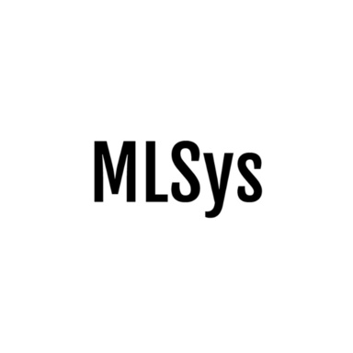

Pathways: Asynchronous Distributed Dataflow for ML
Paul Barham, Aakanksha Chowdhery, Jeff Dean, Sanjay Ghemawat, Steven Hand, Dan Hurt, Michael Isard, Hyeontaek Lim, Ruoming Pang, Sudip Roy, Brennan Saeta, Parker Schuh, Ryan Sepassi, Laurent El Shafey, Chandramohan A. Thekkath, Yonghui Wu

Slide 2
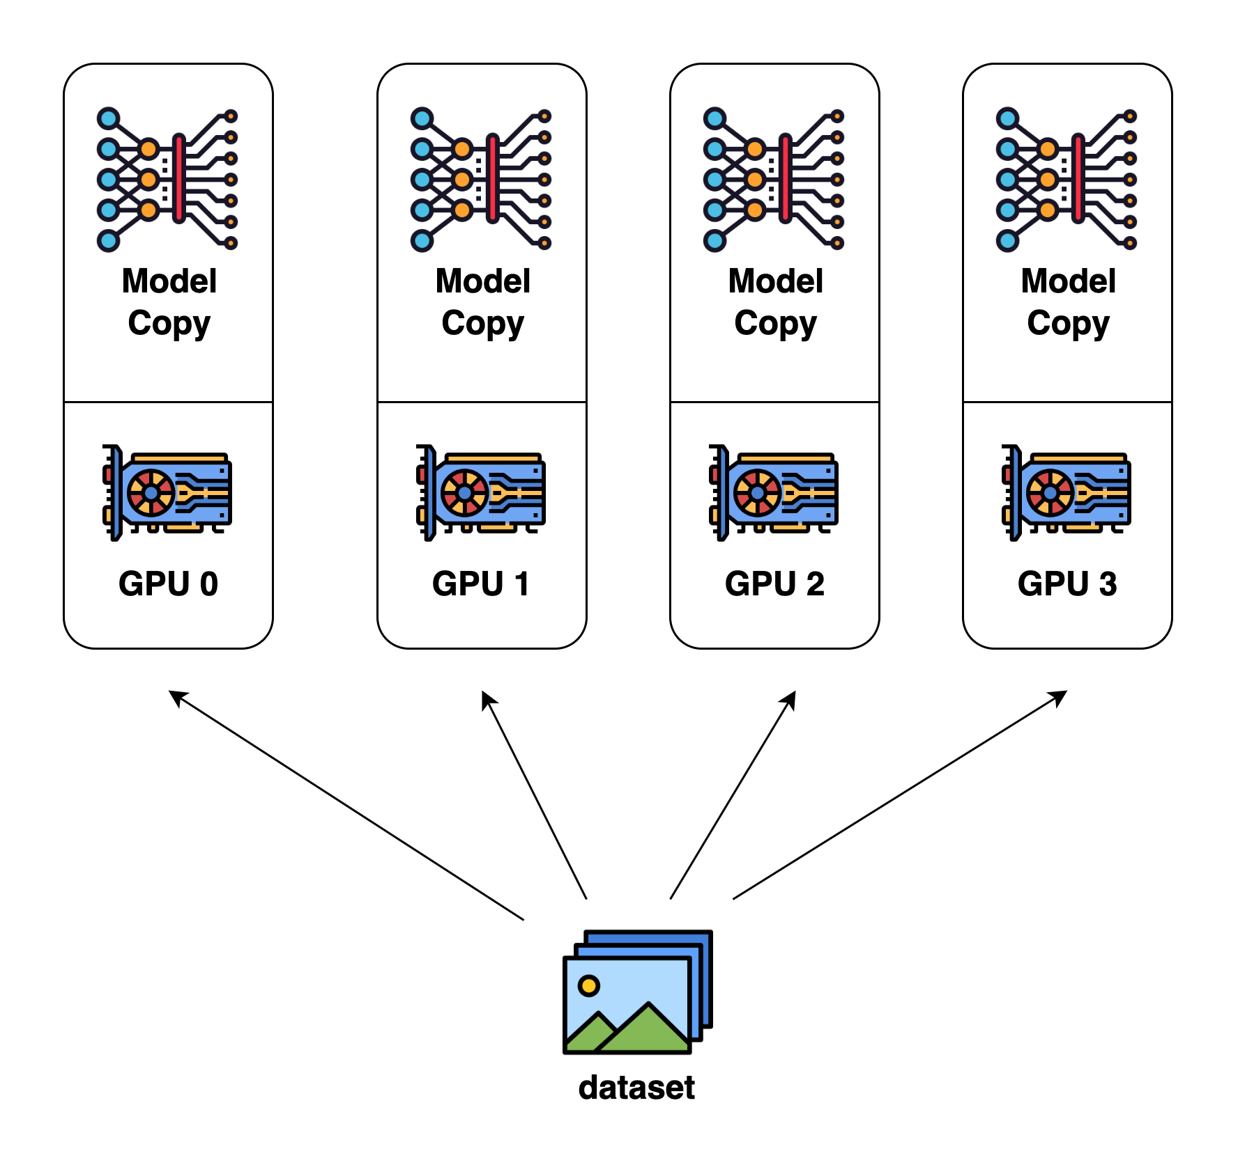
Computation Models in Large-scale ML
Single Program Multiple Data (SPMD) – 1994, MPI
The same program is run on every accelerator.

Slide 3
Computation Models in Large-scale ML
Single Program Multiple Data (SPMD) – 1994, MPI
All Reduce
The same program is run on every accelerator.
Communication is ‘rare’ and done with standard collectives (e.g. All Reduce)
Notes:
Standard communication primitive

Slide 4
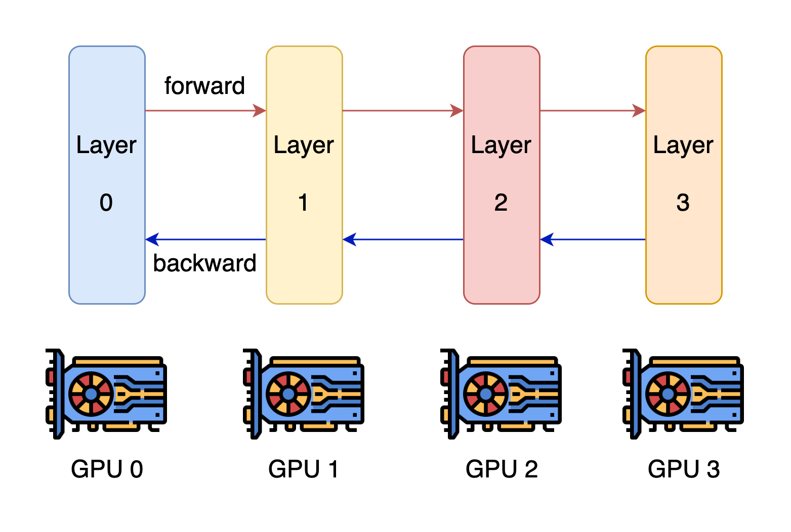
Computation Models in Large-scale ML
Multi Program Multiple Data (MPMD)
Accelerators run heterogeneous computation
Communication is involved in the computation process

Slide 5
Computation Models in Large-scale ML
Multi Program Multiple Data (MPMD)
Accelerators run heterogeneous computation
Communication is involved in the computation process
Examples:
Mixture of Experts (MoE)
Pipeline Parallelism
Network Architecture Search
(NAS)
Computational Sparisity
…

Slide 6
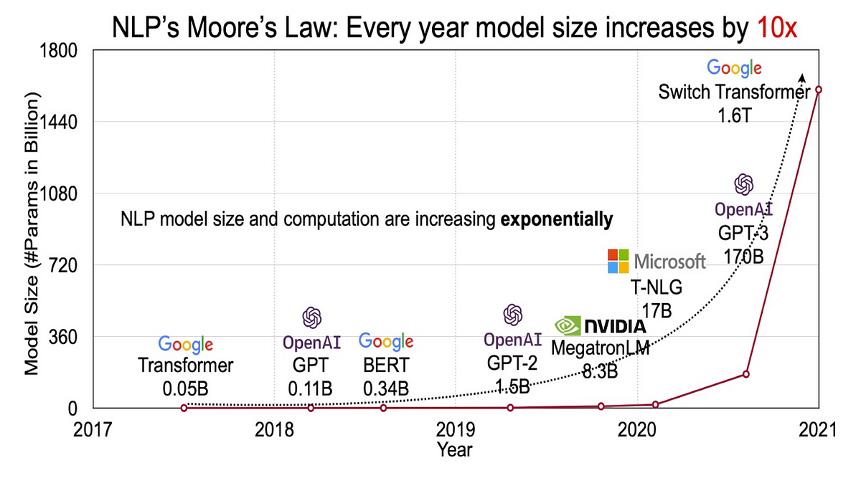
We need heterogeneous computation (MPMD)
Modern deep neural networks are orders of magnitude larger than the capacity of accelerator (HBM) memory

Slide 7
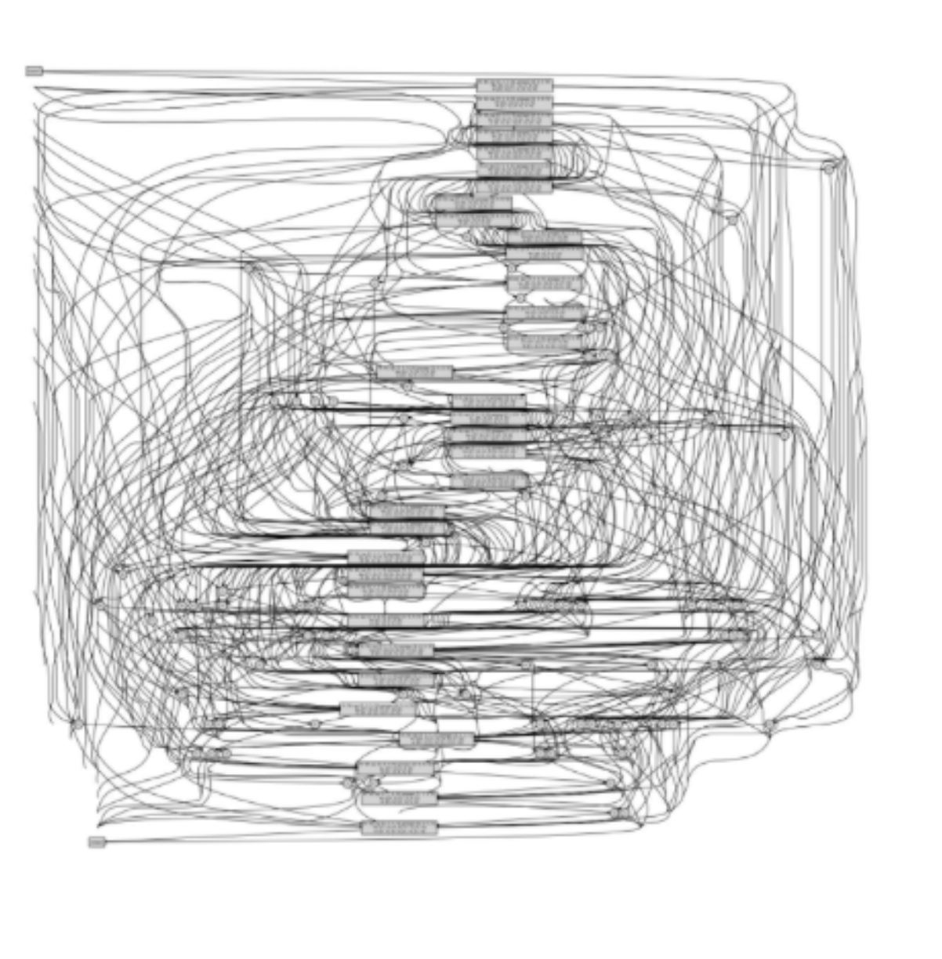
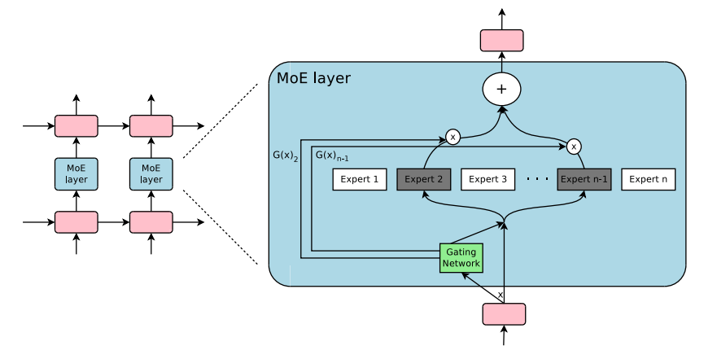
We need heterogeneous computation (MPMD)
Modern deep neural networks are orders of magnitude larger than the capacity of accelerator (HBM) memory
The increasing popularity of heterogeneous models/computations
Mixture of Experts (MoE)
Network Architecture Search (NAS)

Slide 8
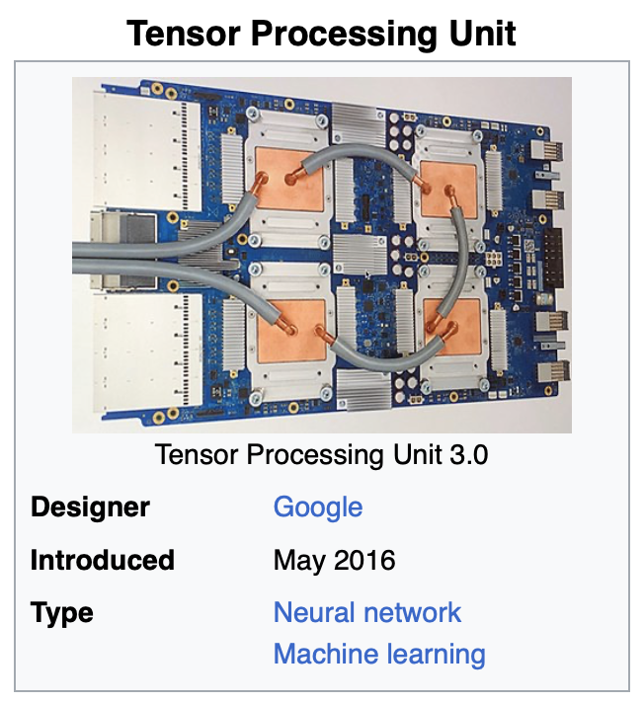
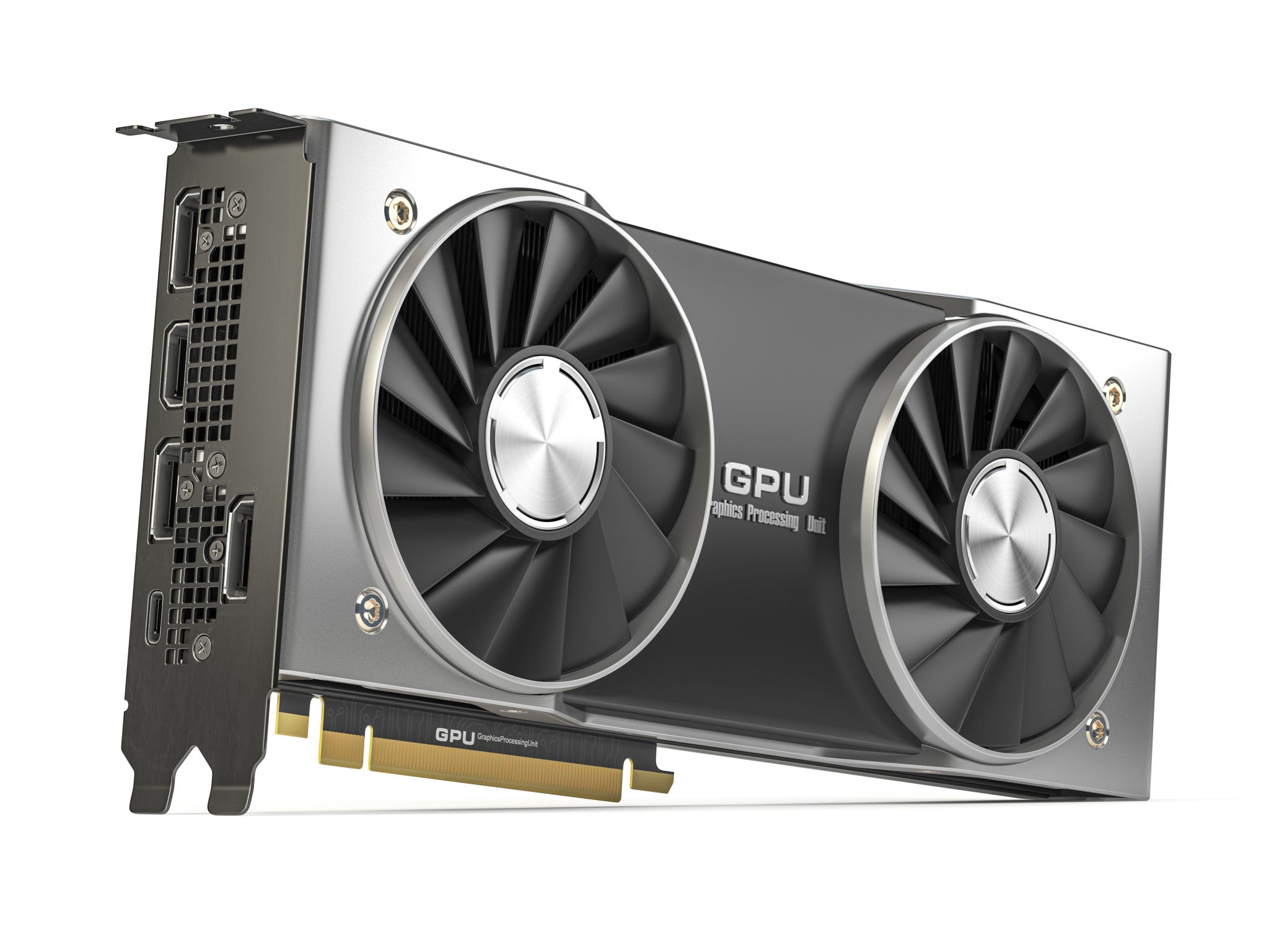
We need heterogeneous computation (MPMD)
The increasing scale of model sizes
The increasing popularity of heterogeneous models/computations
The increasing existence of heterogeneous hardware
Notes:
Different kinds of devices
New generations of devices
→ expensive to maintain homogeneous clusters of devices

Slide 9
Existing Work: Multi-Controller v.s. Single-Controller
Concept – Controller:
A central coordinating component responsible for
distribution of computation (scheduling)
execution of computation
resource allocation
optimizations
…
Goal: To ensure complex computations are efficiently processed.

Slide 10
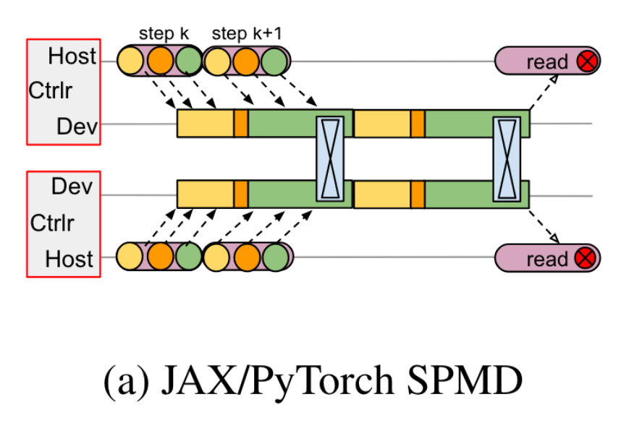
Example: Multi-Controller
Multi-Controller Architecture (e.g. PyTorch, JAX):
Controller is every accelerator itself (by replicating the same code to every accelerator)
Pros
Fast Workload Dispatch (PCI-E communication)
Cons:
Needs non-trivial custom coordinators when executing MPMD

Slide 11
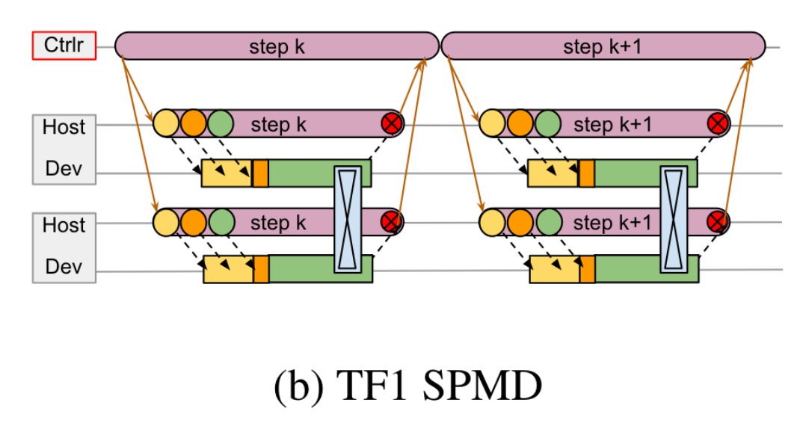
Example: Single-Controller
Single-Controller Architecture (Tensorflow V1)
One central controller that coordinates all worker nodes
Pros:
Generality (not limited to SPMD)
Global Optimizations
Cons:
Slow: Single controller becomes the performance bottleneck
(communication & graph complexity)
Notes:
Probably not adding figure 1c here as we don’t have time and it is a bit too complex to grasp.

Slide 12

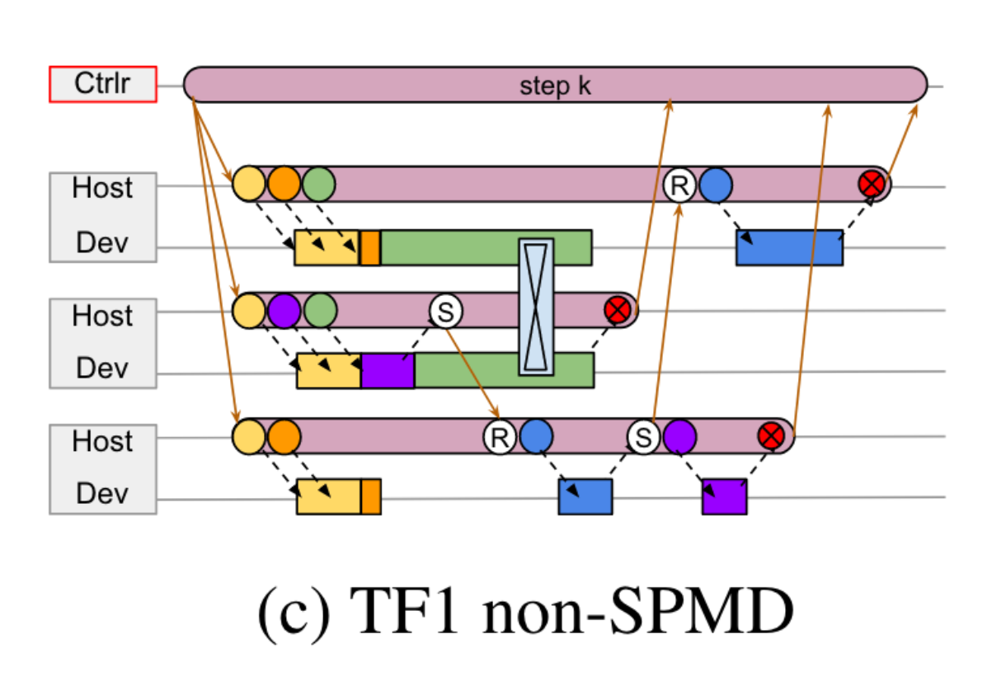
Example: Single-Controller
User’s Input: Computation Graphs
Single-Controller Architecture (Tensorflow V1)
One central controller that coordinates all worker nodes
Pros:
Generality (not limited to SPMD)
Global Optimizations
Cons:
Slow: Single controller becomes the performance bottleneck
(communication & graph complexity)
Notes:
Probably not adding figure 1c here as we don’t have time and it is a bit too complex to grasp.

Slide 13
Existing Work: Multi-Controller v.s. Single-Controller
We want to express MPMD,
but Tensorflow is too slow, and Multi-Controller solutions are too limited…
What about building upon Multi-Controller solutions (e.g. JAX, PyTorch)?
→ Megatron-LM, DeepSpeed

Slide 14
Existing Work: Multi-Controller v.s. Single-Controller
We want to express MPMD,
but Tensorflow is too slow, and Multi-Controller solutions are too limited…
What about building upon Multi-Controller solutions (e.g. JAX, PyTorch)?
Google: No! We want to build a really general (single-controller) yet fast solution. → Pathways
Notes:
Some other motivations:
Enable sharing of devices

Slide 15
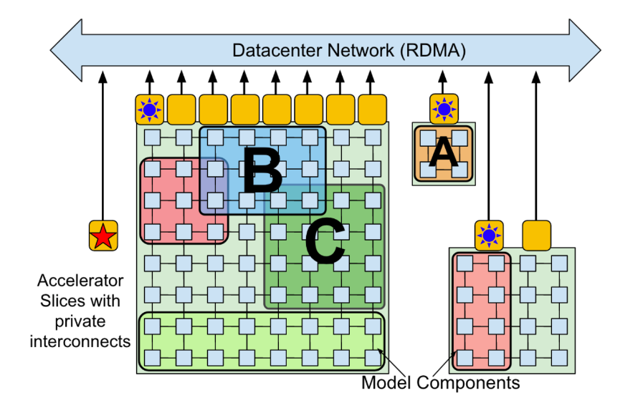
Google’s Data Center
Islands: a cluster (~1000) of all-to-all connected TPU devices, with ~100 hosts
ICI: high-speed interconnect between accelerators (e.g.NVLink)
DCN: slow connection between islands (e.g. Infiniband)

Slide 16
Google’s Data Center
Islands: a cluster (~1000) of all-to-all connected TPU devices, with ~100 hosts
ICI: high-speed interconnect between accelerators (e.g. NCCL)
DCN: slow connection between islands (e.g. Infiniband)
TF1 is slow due to frequent communication over DCN

Slide 17
Google’s Desire
MPMD is the future.
Generality from single-controller with comparable performance to multi-controller.

Slide 18
Resource Virtualization
“Virtual Slice”: A set of virtual devices with specified topology requirements
Physical devices can be added/removed dynamically to/from the slice.

Slide 19
Resource Virtualization
“Virtual Slice”: A set of virtual devices with specified topology requirements
Physical devices can be added/removed dynamically to/from the slice.
Benefit:
Transparent task suspend/resume, and migration
Higher device utilization by
Enable multi-task resource sharing
Decouples user program from resource management
Alleviate user’s responsibility to monitor program failures and keep resource usage high

Slide 20
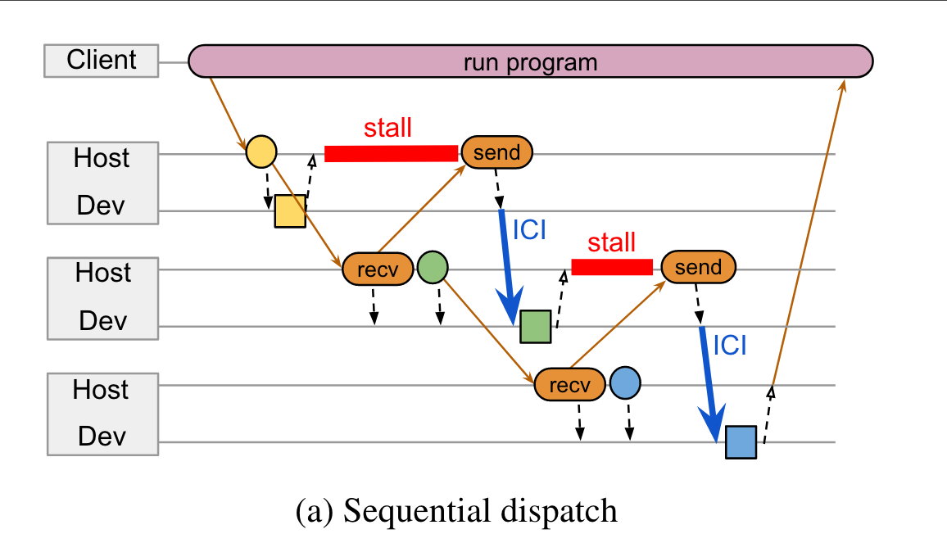
Cross-host Coordination (based on PLAQUE)
Support efficient data transfer between hosts:
Requirements:
Scalability & Latency
Efficient Sparse Communication → Key to fast data-dependent control flow

Slide 21
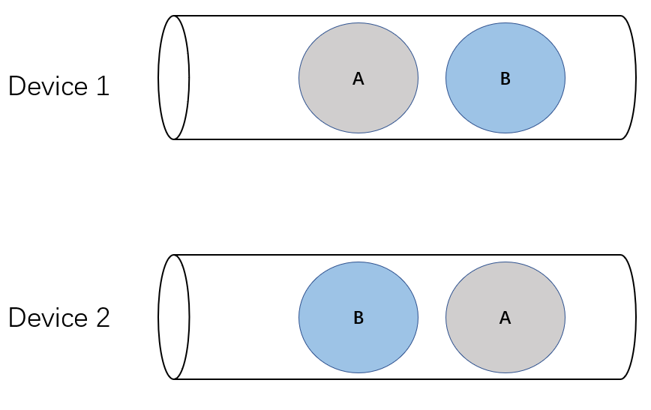
Gang Scheduling
Schedule related tasks together
Deadlock Avoidance (TPU computation are not preemptible)
Higher Throughput (context switch is costly on accelerator)
A and B are independent jobs, and not enforcing execution order might lead to deadlocks.

Slide 22
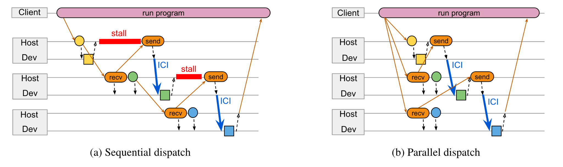
Parallel Asynchronous Dispatch
Pre-allocate resources for computations with known resource requirements (i.e. no data-dependent control flow)

Slide 23
Parallel Asynchronous Dispatch
Pre-allocate resources for computations with known resource requirements (i.e. no data-dependent control flow)
TPUs have only limited support for dynamic shapes, making them a good fit for this technique.

Slide 24
Evaluation of Pathways
Micro Benchmarks
Single-controller dispatch overheads
Multi-tenancy
End-to-End Evaluation
Large-scale model training performance

Slide 25
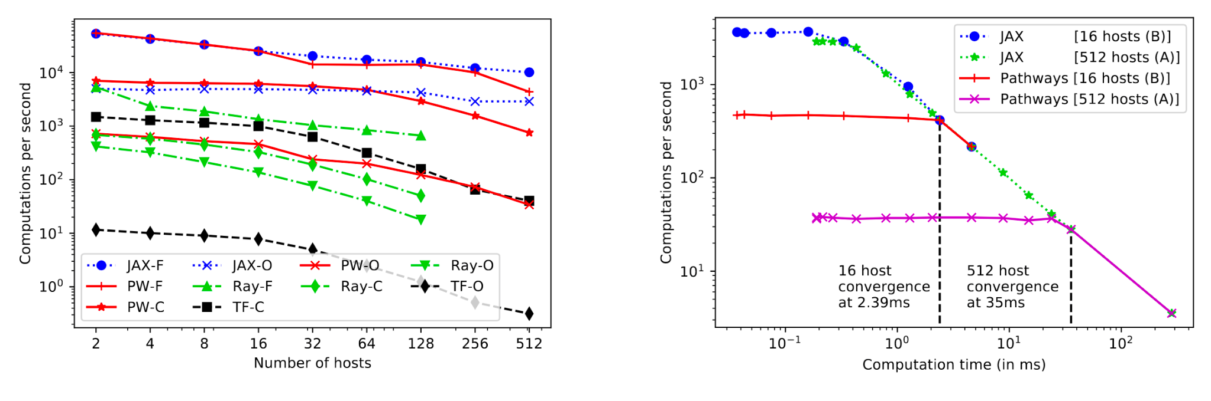
Single-Controller Dispatch Overheads
Little dispatch overhead when computation is not trivial

Slide 26
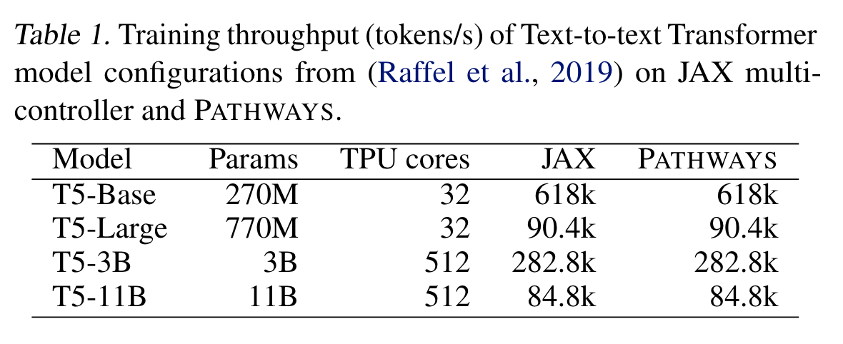
Large-scale model training performance

Slide 27
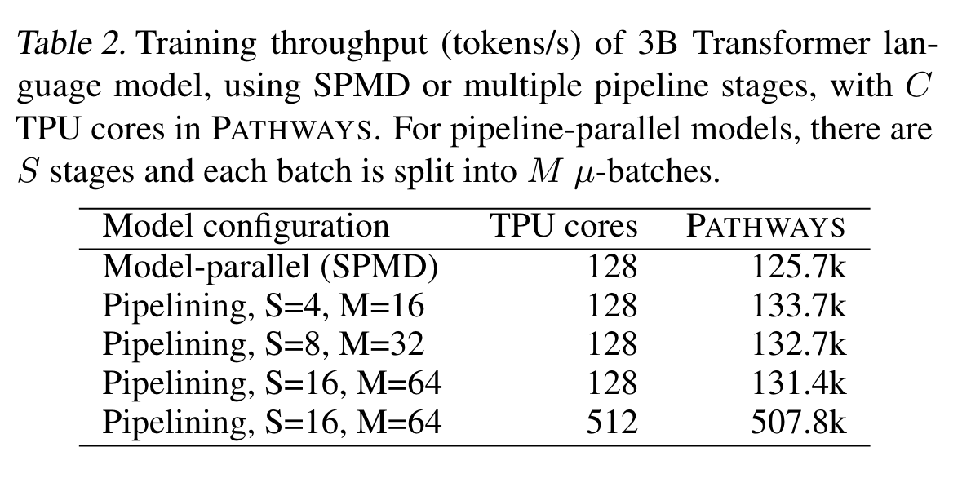
Large-scale model training performance

Slide 28
Summary
Pathways combines single-controller architecture's generality with multi-controller efficiency in ML.
Comparable SPMD performance at large-scale operations.
Parallel dispatch, gang scheduling, and coordination for enhanced efficiency and latency hiding.
Centralized resource management supports multi-tenant sharing and virtualization, tailored for ML tasks.

Slide 29
Limitations
Primarily designed for TPUs, design choices might not hold for GPU
e.g. Gang Scheduling, Parallel Asynchronous Dispatch
Ambiguity in distinct contributions, leveraging many existing systems & techniques.
Incomplete evaluation
lacking end-to-end comparisons with frameworks like Ray.
performance benefit might lie in implementation (e.g. on-device object store) instead of design
Performance benefit might not show for small-scaled workloads
…

Slide 30

Efficient Large-Scale Language Model Training on GPU Clusters
Using Megatron-LM
Deepak Narayanan, Mohammad Shoeybi , Jared Casper, Patrick LeGresley, Mostofa Patwary, Vijay Korthikanti, Dmitri Vainbrand, Prethvi Kashinkunti, Julie Bernauer, Bryan Catanzaro, Amar Phanishayee, Matei Zaharia

Slide 31
Megatron-LM: Context
Can we use a single GPU for training an LLM?
No — GPU memory too small!
Impossible to fit large models on even a A100 (80GB device memory)
No — it would take too long!
Training GPT-3, with 175 billion parameters, takes 288 years with a single V100 NVIDIA GPU
Solution: 1D (Data) Parallelism

Slide 32
1D parallelism
Can we use k GPUs, and give each GPU data batches of batch_size / k?
Data-parallel scale out usually works well..
For large k, per-GPU batch becomes too small
Reduced GPU utilization
Increased communication cost
Can have at most batch_size GPUs
Batchsize == 1024 → at most 1024 data parallel instances
Too limited!
Better Solution: 3D Parallelism
Notes:
Explain why scale out parallelism is slower than it could be
Want each node to have a similar compute time,

Slide 33
Megatron-LM: Motivation
“3D Parallelism” or “PTD-P” if you love acronyms
Three Different Methods of Parallelism
Combine the three methods based on training workload
Parallelizing the workflow adds overhead
Notes:
(Megatron paper provides heuristics for this)
(network calls, cost of partitioning data/model weights, stalling/”pipeline bubble”)

Slide 34
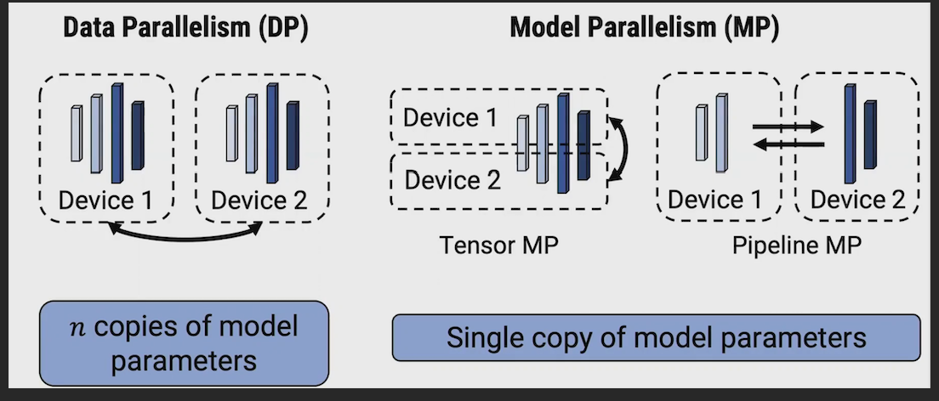
“3D Parallelism”

Slide 35
“3D Parallelism”
Data
Shard input data across multiple nodes
Each node processes its data with an entire copy of the model (or a shard of model weights)
weights periodically reaggregated

Slide 36
“3D Parallelism”
Model Parallelism
Split model across GPUs
Pipeline MP = split layers
Tensor MP = split weights

Slide 37
Megatron-LM: Motivation
“3D Parallelism”

Slide 38
Megatron-LM: Motivation
“3D Parallelism”
Data
Shard input data across multiple nodes
Each node processes its data with an entire copy of the model (or a shard of model weights)
weights periodically reaggregated

Slide 39
Megatron-LM: Motivation
“3D Parallelism”
Pipeline Model Parallelism
Distribute different layers of model across multiple GPUs, each processing a part of the model
Megatron only considers sharding homogenous transformer layers
Megatron-LM wants to maintain optimizer correctness, which requires all of the model layers to finish before weights are updated and used
Clever pipeline interleavings cut down on the pipeline stalls/“pipeline bubble” time

Slide 40
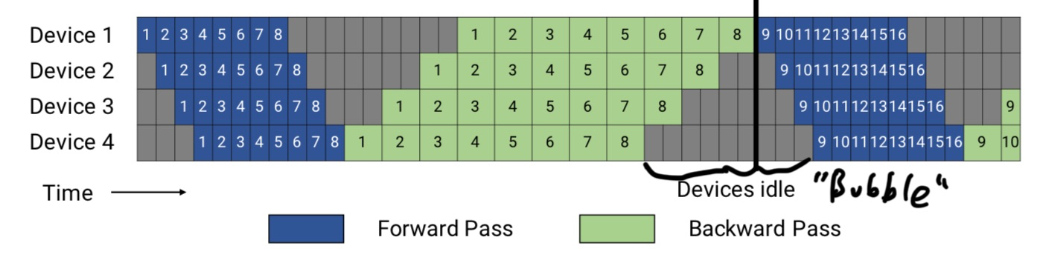
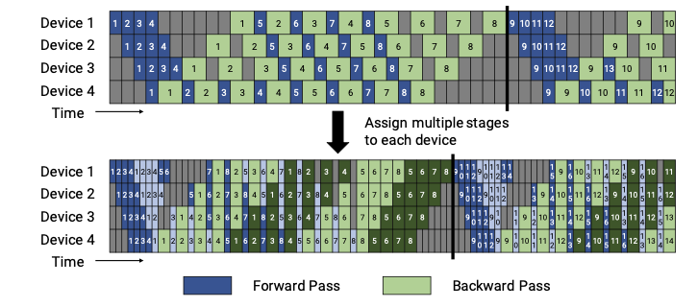
Notes:
Top picture: Naive pipeline schedule
Middle picture: “Pipedream-Flush” where only pipeline depth microbatches are run. (more memory efficient when depth much smaller than number of microbatches
Bottom picture: Instead of partitioning into contiguous layers, split into non-contiguous subsets (device 1 has 1,2,9,10

Slide 41
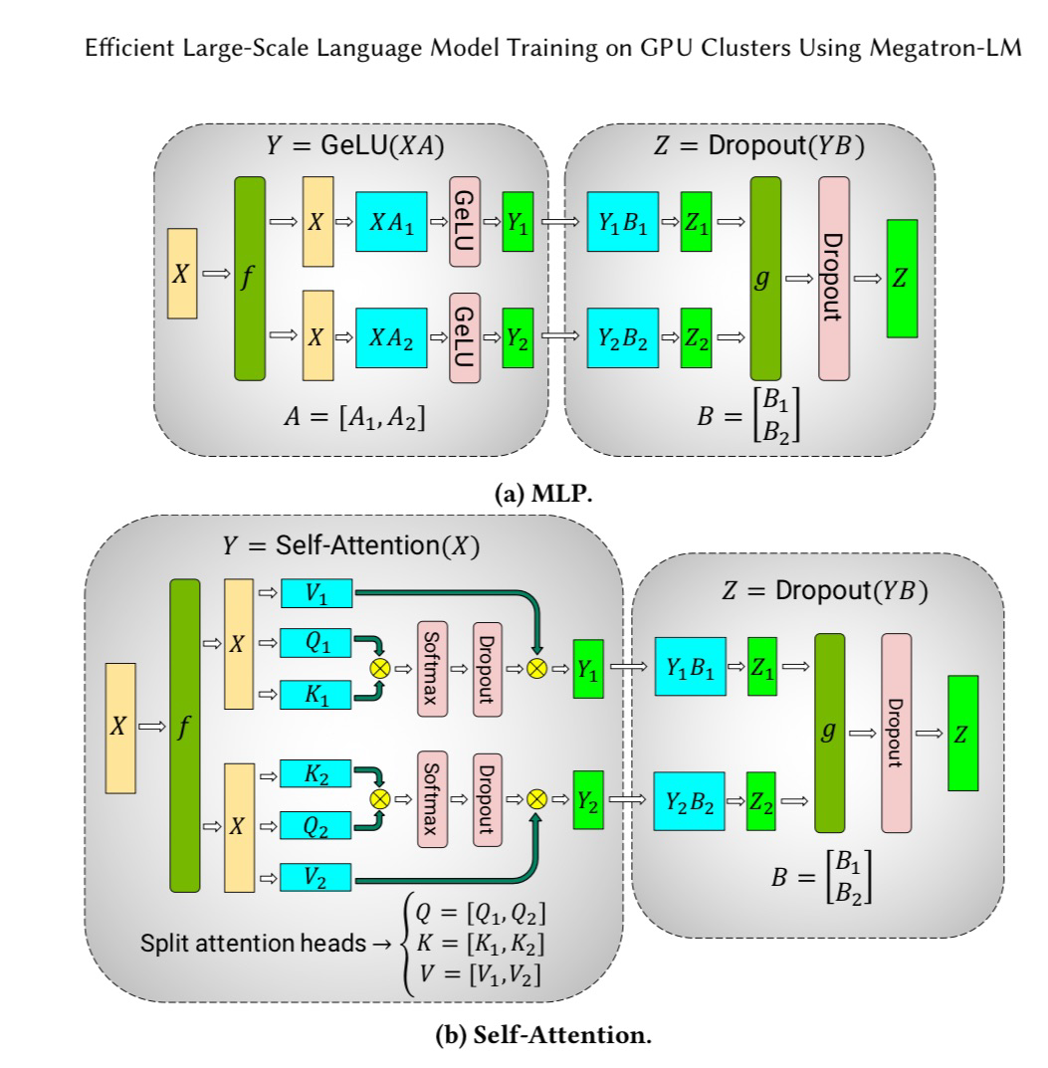
Megatron-LM: Motivation
“3D Parallelism”
Tensor Model
Partition layers of the model and model weights across multiple devices
In Megatron, they split the post-attention calculation MLP update across multiple devices
Partitioning overhead: 4 all-reduce operations to split up matrices
Notes:
Split attention matrix column wise (if we split across rows then since GeLU is non-linear, we would need to wait for synchronization).

Slide 42
Transformer
Layer #1
Layer #2
Layer #3
Layer #4

Slide 43
Transformer
Layer #1
Layer #2
Layer #3
Layer #4
PP #1
PP #2

Slide 44
Transformer
Layer #1
Layer #2
Layer #3
Layer #4
TP #0
PP #1
PP #2

Slide 45
Transformer
Layer #1
Layer #2
Layer #3
Layer #4
TP #0
TP #1
PP #1
PP #2

Slide 46
Transformer
Layer #1
Layer #2
Layer #3
Layer #4
TP #0
TP #2
TP #1
TP #3
PP #1
PP #2

Slide 47
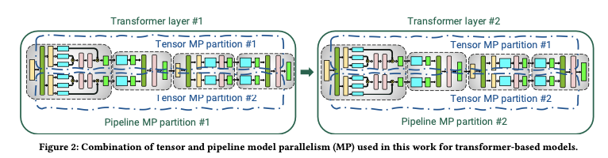
Callback to Intro to Transformers presentation
How can we minimize the overhead of parallelization?

Slide 48
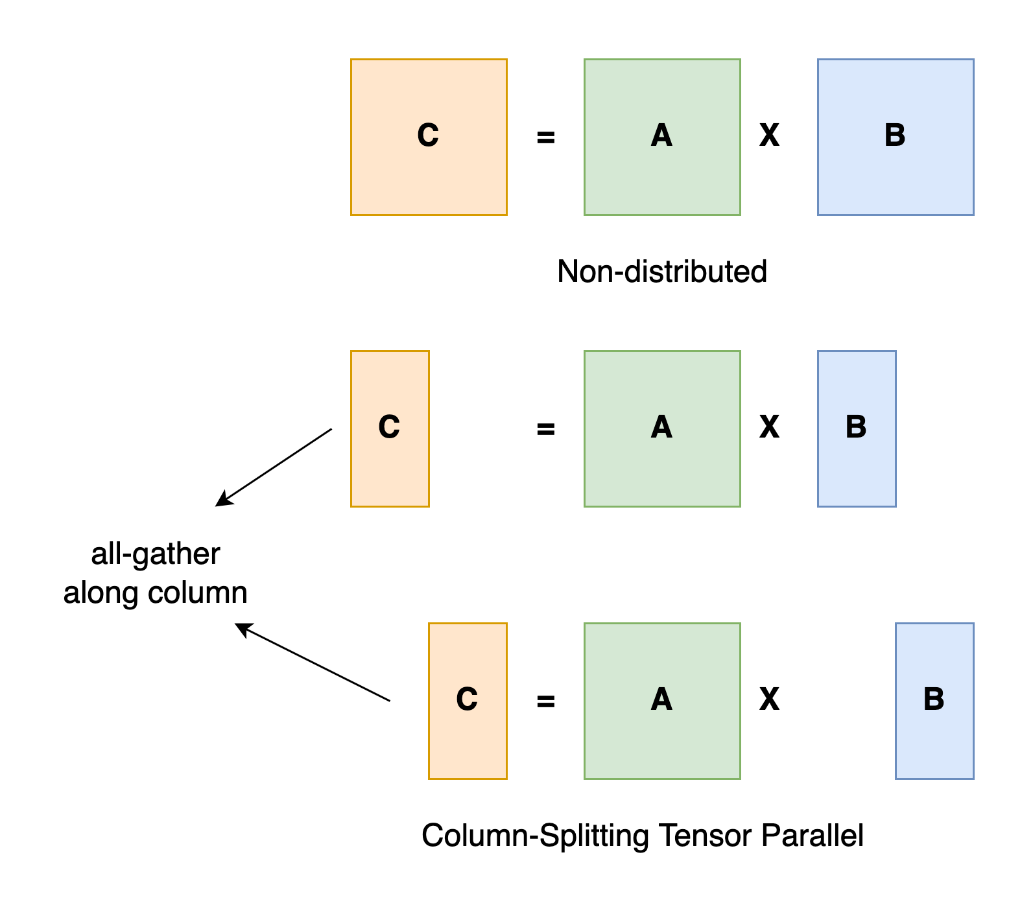
Implementation and Optimizations
Written in PyTorch
github.com/NVIDIA/Megatron-LM
Communication optimization
Scatter-gather (11% speedup)
Fuse together kernels
Also 11% speedup

Slide 49
Megatron-LM: Contributions
Combine several parallelism techniques
Pipeline parallelism across multi-GPU servers
Tensor parallelism within multi-GPU server
Data parallelism
Reason about performance, performance interactions of modes of parallelism

Slide 50
DELETE DELETE Moved to Marwa’s Optimization Section
Megatron-LM: Contributions
Describe some heuristics for when each part of parallelism should be applied
Tensor + Pipeline Parallelism
Reduce “bubble” via tensor parallelism
If you have g GPUs/server, create g tensor partitions, and then apply pipeline model paralleism
Data + Model Parallelism
Use t (tensor-model-parallel size) * p (pipeline-model-parallel-size) should be used
Optimal Microbatch size
Depends on everything.

Slide 51
Megatron-LM: PTD-P
Combine the “good” of parallelism techniques
Pipeline parallelism across multi-GPU servers
Tensor parallelism within multi-GPU server
Data parallelism
Along with compute-bound kernel, smart partitioning, good hardware, communication optimization…
These are additional optimizations that elevate PTD-P (the core) into Megatron-LM
And along with “careful” engineering

Slide 52
Megatron-LM: PTD-P
Combine the “good” of parallelism techniques
Pipeline parallelism across multi-GPU servers
Tensor parallelism within multi-GPU server
Data parallelism
Along with compute-bound kernel, smart partitioning, good hardware, communication optimization…
These are additional optimizations that elevate PTD-P (the core) into Megatron-LM
And along with “careful” engineering
What we get:
Graceful scaling
Optimized cluster environment
High bandwidth links between GPUs on same server and across

Slide 53
Performance of Different Parallization Configurations
Tensor + Pipeline Model Parallelism
If you have g GPUs, first do g tensor model partitions, then scale out with pipeline model parallelism
Todo add the takeaways from the other combinations

Slide 54
Megatron-LM: Evaluation
Experiment setup
Mixed precision on Selene Supercomputer
For each node/cluster
8 NVIDIA 80-GB A100 GPUs
NVIDIA Mellanox HCAs for application communication
Three-level fat-tree topology
Fast all-reduce communication
Notes:
Selene Supercomputer – supports immense computational power for handling large-scale language model training.
8 Nodes per cluster – optimize parallel processing and memory utilization; maybe balance between the computation and communication overhead; training is more efficient.
Fat-Tree Topology — network topology. Handles the high bandwidth requirements of large-scale distributed computing. Helps with synchronizing data among multiple nodes during training process.

Slide 55
Megatron-LM: Evaluation
Experiment setup
Mixed precision on Selene Supercomputer
For each node/cluster
8 NVIDIA 80-GB A100 GPUs
NVIDIA Mellanox HCAs for application communication
Three-level fat-tree topology
Fast all-reduce communication
Goal
Notes:
Selene Supercomputer – supports immense computational power for handling large-scale language model training.
8 Nodes per cluster – optimize parallel processing and memory utilization; maybe balance between the computation and communication overhead; training is more efficient.
Fat-Tree Topology — network topology. Handles the high bandwidth requirements of large-scale distributed computing. Helps with synchronizing data among multiple nodes during training process.

Slide 56
Megatron-LM: Evaluation
Experiment setup
Mixed precision on Selene Supercomputer
For each node/cluster
8 NVIDIA 80-GB A100 GPUs
NVIDIA Mellanox HCAs for application communication
Three-level fat-tree topology
Fast all-reduce communication
Goal
Take large-scale GPT models (mostly just GPT-3)
Notes:
Selene Supercomputer – supports immense computational power for handling large-scale language model training.
8 Nodes per cluster – optimize parallel processing and memory utilization; maybe balance between the computation and communication overhead; training is more efficient.
Fat-Tree Topology — network topology. Handles the high bandwidth requirements of large-scale distributed computing. Helps with synchronizing data among multiple nodes during training process.

Slide 57
Megatron-LM: Evaluation
Experiment setup
Mixed precision on Selene Supercomputer
For each node/cluster
8 NVIDIA 80-GB A100 GPUs
NVIDIA Mellanox HCAs for application communication
Three-level fat-tree topology
Fast all-reduce communication
Goal
Take large-scale GPT models (mostly just GPT-3)
Incorporate Megatron framework
Notes:
Selene Supercomputer – supports immense computational power for handling large-scale language model training.
8 Nodes per cluster – optimize parallel processing and memory utilization; maybe balance between the computation and communication overhead; training is more efficient.
Fat-Tree Topology — network topology. Handles the high bandwidth requirements of large-scale distributed computing. Helps with synchronizing data among multiple nodes during training process.

Slide 58
Megatron-LM: Evaluation
Experiment setup
Mixed precision on Selene Supercomputer
For each node/cluster
8 NVIDIA 80-GB A100 GPUs
NVIDIA Mellanox HCAs for application communication
Three-level fat-tree topology
Fast all-reduce communication
Goal
Take large-scale GPT models (mostly just GPT-3)
Incorporate Megatron framework
See how it performs in model training
Notes:
Selene Supercomputer – supports immense computational power for handling large-scale language model training.
8 Nodes per cluster – optimize parallel processing and memory utilization; maybe balance between the computation and communication overhead; training is more efficient.
Fat-Tree Topology — network topology. Handles the high bandwidth requirements of large-scale distributed computing. Helps with synchronizing data among multiple nodes during training process.

Slide 59
Megatron-LM: Evaluation
How well does PTD-P Perform?

Slide 60
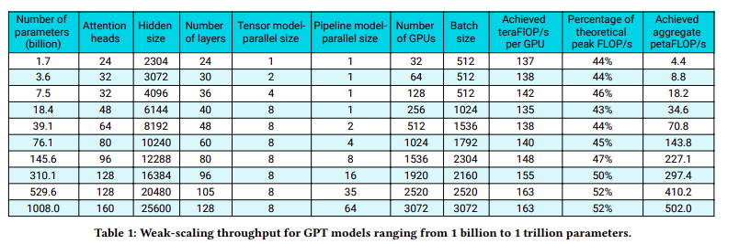
Megatron-LM: Evaluation
How well does PTD-P Perform?
Notes:
Batch Size – number of training examples processed simultaneously. Bigger model means bigger batch size.
Achieved teraFLOP/s per GPU —This metric shows the computational performance per GPU in teraFLOPs per second. The values indicate how efficiently each GPU is utilized during training.
Percentage of Theoretical Peak FLOP/s —This percentage shows how close the achieved performance is to the theoretical maximum performance of the GPUs. Higher percentages indicate more efficient utilization of the GPU's capabilities.
Achieved Aggregate petaFLOP/s— Represents the total computational power across all GPUs in petaFLOPs per second. This metric gives a sense of the overall computational power harnessed for training the models.
Other things: increase in number of attention heads, hidden size, as model increases. The size used for tensor model parallelism (how the model is split across GPUs), the size used for pipeline model parallelism (how the layers are distributed across the pipeline), and the total number of GPUs utilized.

Slide 61
Megatron-LM: Evaluation
How well does PTD-P Perform?
End-to-end training time ~three months for trillion parameter model
Notes:
Batch Size – number of training examples processed simultaneously. Bigger model means bigger batch size.
Achieved teraFLOP/s per GPU —This metric shows the computational performance per GPU in teraFLOPs per second. The values indicate how efficiently each GPU is utilized during training.
Percentage of Theoretical Peak FLOP/s —This percentage shows how close the achieved performance is to the theoretical maximum performance of the GPUs. Higher percentages indicate more efficient utilization of the GPU's capabilities.
Achieved Aggregate petaFLOP/s— Represents the total computational power across all GPUs in petaFLOPs per second. This metric gives a sense of the overall computational power harnessed for training the models.
Other things: increase in number of attention heads, hidden size, as model increases. The size used for tensor model parallelism (how the model is split across GPUs), the size used for pipeline model parallelism (how the layers are distributed across the pipeline), and the total number of GPUs utilized.

Slide 62
Megatron-LM: Evaluation
How well does PTD-P Perform?
End-to-end training time ~three months for trillion parameter model
Before Megatron: Training GPT-3, with 175 billion parameters, takes 288 years with a single V100 NVIDIA GPU
Notes:
The second statistic is kind of misleading.
Batch Size – number of training examples processed simultaneously. Bigger model means bigger batch size.
Achieved teraFLOP/s per GPU —This metric shows the computational performance per GPU in teraFLOPs per second. The values indicate how efficiently each GPU is utilized during training.
Percentage of Theoretical Peak FLOP/s —This percentage shows how close the achieved performance is to the theoretical maximum performance of the GPUs. Higher percentages indicate more efficient utilization of the GPU's capabilities.
Achieved Aggregate petaFLOP/s— Represents the total computational power across all GPUs in petaFLOPs per second. This metric gives a sense of the overall computational power harnessed for training the models.
Other things: increase in number of attention heads, hidden size, as model increases. The size used for tensor model parallelism (how the model is split across GPUs), the size used for pipeline model parallelism (how the layers are distributed across the pipeline), and the total number of GPUs utilized.

Slide 63
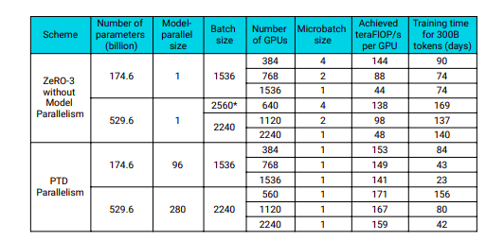
Megatron-LM: Evaluation
How well does PTD-P Perform against other models?

Slide 64
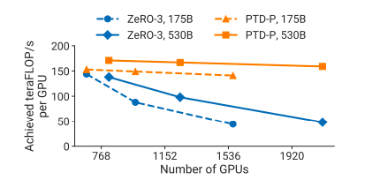
Megatron-LM: Evaluation
How well does PTD-P Perform against other models?
Notes:
Zero-3 only ever combined with data parallelism and does not use model or tensor
“Cherry picking”
Less cross node parallelism
PTD-P is 70% more effective when we double GPUs
PTD-P's superior performance is its reduced reliance on cross-node parallelism compared to ZeRo-3; fewer nodes in parallel or has a lower degree of task distribution / coordination? So you avoid the overheads or complexities associated with extensive cross-node parallel processing, such as network communication overhead, data synchronization, etc.

Slide 65
Megatron-LM: Evaluation
How well does PTD-P Perform against other models?
PTD-P scales more gracefully than ZeRO-3 in isolation
Notes:
Zero-3 only ever combined with data parallelism and does not use model
“Cherry picking”

Slide 66
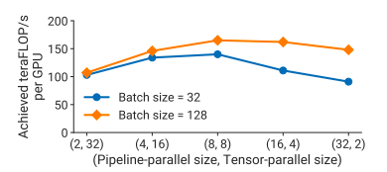
Megatron-LM: Comparison of Parallel Configurations
Notes:
GPT model with 162 billion parameters, 64 GPUs.
GPT model uses both pipeline and tensor parallelism (characteristics of Megatron but not exactly Megatron)
Peak performance: tensor parallel size == number GPUs in a single node. We see best performance when the division of the model across the tensor dimension (parallelism) matches the number of GPUs available in a single node.
Both methods combined can maximize utilization of computational resources, hence peak performance. Not directly about pipeline stages but rather about the efficient use of GPUs within a node for tensor parallelism.

Slide 67
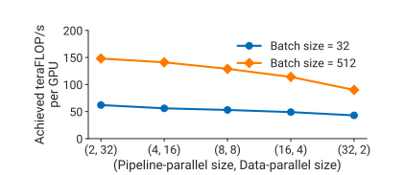
Megatron-LM: Comparison of Parallel Configurations
Notes:
Optimization heuristics
We can see that throughput decreases as pipeline parallel size increases.
Pipeline model parallelism should be used primarily to support the training of large models that do not fit on a single worker, and data parallelism should be used to scale up training.
Pipeline model parallelism should be used primarily to support the training of large models that do not fit on a single worker, and data parallelism should be used to scale up training.

Slide 68
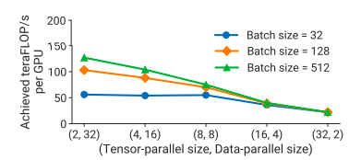
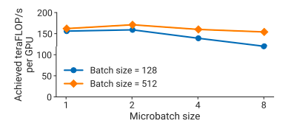
Comparison of Parallel Configurations, Microbatch Size
Notes:
Optimization heuristics
As the tensor-model-parallel size increases, we perform smaller matrix multiplications on every GPU, decreasing utilization on each GPU.
Microbatch just depends on EVERYTHING

Slide 69
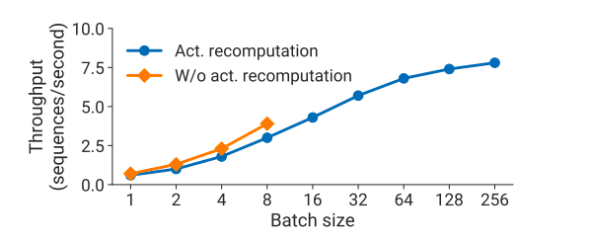
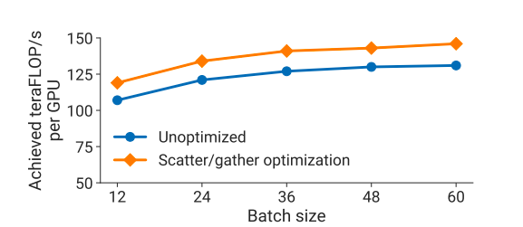
Comparison of Activation Recompution, Scatter/Gather

Slide 70
Megatron-LM: Discussion
PTD-P := “3D Parallelism”
High aggregate throughput (502 petaFLOP/s) even with exponential parameter growth
Reasonable end-to-end training times (3 months for a trillion-parameter model)
Notes:
Builds on quirks of Nvidia graphics card; really specific GPU in a specific network

Slide 71
Megatron-LM: Discussion
PTD-P := “3D Parallelism”
High aggregate throughput (502 petaFLOP/s) even with exponential parameter growth
Reasonable end-to-end training times (3 months for a trillion-parameter model)
Each method of parallelism has its own trade-offs
Ex: Data Parallel Scale-out
But when combined, with “careful” engineering (and some cherry picking), very powerful
Notes:
Builds on quirks of Nvidia graphics card; really specific GPU in a specific network

Slide 72
Megatron-LM: Discussion
PTD-P := “3D Parallelism”
High aggregate throughput (502 petaFLOP/s) even with exponential parameter growth
Reasonable end-to-end training times (3 months for a trillion-parameter model)
Each method of parallelism has its own trade-offs
Ex: Data Parallel Scale-out
But when combined, with “careful” engineering (and some cherry picking), very powerful
Megatron-LM is very [Nvidia A100] GPU-Centric
How can we translate to other accelerators (i.e. TPUs)?
Notes:
Builds on quirks of Nvidia graphics card; really specific GPU in a specific network
Compute-bound kernel implementations, smart partitioning across multiple GPUs, domain specific optimizations, fast hardware, etc.

Slide 73
Megatron-LM: Future Directions
Future Directions: translate to other types of accelerators

Slide 74
Megatron-LM: Future Directions
Future Directions: translate to other types of accelerators
Accelerator agnostic:
Smart partitioning to minimize communication and maintain activity

Slide 75
Megatron-LM: Future Directions
Future Directions: translate to other types of accelerators
Accelerator agnostic:
Smart partitioning to minimize communication and maintain activity
Minimize number of memory-bound kernels with operator fusion

Slide 76
Megatron-LM: Future Directions
Future Directions: translate to other types of accelerators
Accelerator agnostic:
Smart partitioning to minimize communication and maintain activity
Minimize number of memory-bound kernels with operator fusion
Other domain-specific optimizations (scatter-gather)

Slide 77
Megatron-LM: Future Directions
Future Directions: translate to other types of accelerators
Accelerator agnostic:
Smart partitioning to minimize communication and maintain activity
Minimize number of memory-bound kernels with operator fusion
Other domain-specific optimizations (scatter-gather)
No quantitative measuring of communication overhead (complex network topology, different speeds for intra-server and between-server transfers, etc)
Notes:
“No quantitative measuring of communication overhead (complex network topology, different speeds for intra-server and between-server transfers, etc)”
Need more detailed analysis and measurement of the communication costs associated with different types of network traffic in distributed deep learning models.

Slide 78
Megatron-LM: Related Works
Other techniques to train models at scale
Pipeline model parallelism
Megatron — flushes to ensure strict optimizer semantics
TeraPipe — auto-regressive, fine-grained parallelism across tokens
PipeTransformer — pipe and data parallelism
PipeDream — relaxed semantics; 1-stale weight update w/out expensive flushes
Sharded Data Parallelism
Automatic Partitioning
Flexflow
HPC for Model Training
ImageNet

Slide 79
Future of Parallel Computing: Pathways & Megatron-LM
New types of parallelism often require a constant coordinator, like Megatron

Slide 80
Future of Parallel Computing: Pathways & Megatron-LM
New types of parallelism often require a constant coordinator, like Megatron
Pathways architecture wants a very general computation graph to allow for optimizations without Megatron

Slide 81
Future of Parallel Computing: Pathways & Megatron-LM
New types of parallelism often require a constant coordinator, like Megatron
Pathways architecture wants a very general computation graph to allow for optimizations without Megatron
Two divergent approaches:
Pathways: universal and adaptable computation graph
Megatron: coordinator-reliant parallelism upon existing SPMD systems

Slide 82
Future of Parallel Computing: Pathways & Megatron-LM
New types of parallelism often require a constant coordinator, like Megatron
Pathways architecture wants a very general computation graph to allow for optimizations without Megatron
Two divergent approaches:
Pathways: universal and adaptable computation graph
Megatron: coordinator-reliant parallelism upon existing SPMD systems
Two approaches to the future of parallel computing in ML

Slide 83
Future of Parallel Computing: Pathways & Megatron-LM
New types of parallelism often require a constant coordinator, like Megatron
Pathways architecture wants a very general computation graph to allow for optimizations without Megatron
Two divergent approaches:
Pathways: universal and adaptable computation graph
Megatron: coordinator-reliant parallelism upon existing SPMD systems
Two approaches to the future of parallel computing in ML
Add layers of complexity to current architecture or start from scratch?

Slide 84
Q&A

